Slide 1
CI/CD Implementation

Slide 2
Agenda
Why CI/CD
CI/CD Overview
Continuous Integration
Continuous Testing
Continuous Delivery
Typical CI/CD cycle
30,60, 90 Day Plan
2

Slide 3

Why CI/CD
Continuous Integration : CI is the practice of testing each change done to your codebase automatically and as early as possible. All the developers check in the code at-least once a day and whenever a check in happens , build is automatically triggered.
Continuous Testing: Continuous testing takes CI one step further. After the build and Unit testing are successful , the system testing, integration testing , regression testing, performance testing & security testing are auto triggered.
Continuous Delivery : Continuous Delivery automates deploying all code changes to a testing environment and/or a production environment after the build stage. This make sure the availability of a ready code.
Return On
Investment
Early bug Detection
Automated Deployment
Quality of delivery
Self-Testing Build
Benefits
ROI
Increase release cadence
Code Consolidation
Return of Investment
Revision Control
Fast Build

Slide 4
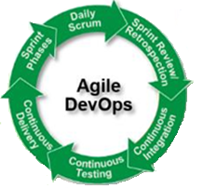
CI CD Overview
Agile Adaptation
Continuous Integration
Product Backlog
Sprint Backlog
Potentially Shippable Product
For Resolution
Dev1
Resolved
Code Merge
Code Conflict
Unit Testing
Code Build
Burn down Chart
User Stories
Continuous Feedback
Dev2
Low
*70%
High
Continuous Feedback
Complexity
Automation Potential
Benefit / ROI
* Considering 30-40% automation in Code merge due to frequent code conflict issues & 70-80% automation in Code Coverage due to existing code base without unit test cases.
Continuous Feedback
Continuous Delivery
Continuous Testing
Dev
QA
Deploy
Build
Security
Performance
Regression
System ATDD
Prod
Continuous Feedback
Medium
*70-90%
Medium
High
*70-90%
High
Complexity
Automation Potential
Benefit / ROI
Complexity
Automation Potential
Benefit / ROI
* Considering lower % of automation in Network Config
* Considering lower % of automation in Performance Testing

Slide 5







Continuous Integration
Development practice that requires developers to integrate code into a shared repository several times a day. Each check-in is then verified by an automated build, allowing teams to detect problems early.
Each check-in is then verified by an automated build, allowing teams to detect problems early.
By integrating regularly, you can detect errors quickly, and locate them more easily.
Significantly less back-tracking to discover where things went wrong, so you can spend more time building features.
Key Benefits of Continuous Integration
Early defect
detection
Reduce overheads
Measurable health
Of software
Better project
visibility
Bring quality
assurance
Reduce
assumptions
Pull Changes
Developer
SOURCE
CONTROL
BUILD
SERVER
BUILD
PUBLISHING
My Server
Developer
My Server
Developer
My Server
Push Changes
AUTOMATED
TESTS
NOTIFICATIONS
Test Server

Slide 6
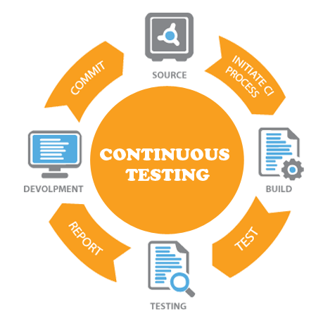
Continuous Testing
Continuous testing is the process of executing automated tests as part of the software delivery pipeline to obtain immediate feedback on the business risks associated with a software release candidate
The goal of Continuous Testing is to apply "extreme automation" to a stable, production-like test environments.
Moving from automated testing to continuous testing involves executing a set of tests that is specifically designed to assess the business risks associated with a release candidate
Why Continuous Testing
Quick Defect Detection
Functional Software availability
Risks are Reduced
Better Project Visibility

Slide 7
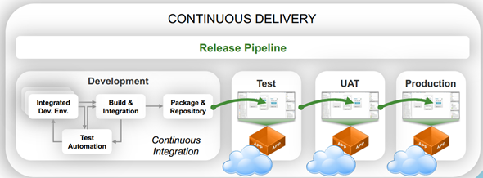

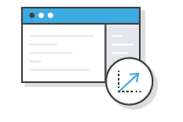


Continuous Delivery
Continuous delivery (CD) is a software engineering approach in which teams produce software in short cycles, ensuring that the software can be reliably released at any time.
Expands upon continuous integration by deploying all code changes to a testing environment and/or a production environment after the build stage.
When continuous delivery is implemented properly, developers will always have a deployment-ready build artifact that has passed through a standardized test process.
Automate the Software Release Process
Improve Developer Productivity
Find and Address Bugs Quicker
Deliver Updates Faster

Slide 8

















Typical CI/CD Cycle
# Tools mentioned are representative sample and not complete set
Continuous Integration
Code Management
Code Merge
Packaging
Build (CI) Server
Unit Testing
Code Coverage
Security Scan
Dev
Dev/SME
Dev/SME
Architect/SME
Dev/SME
Dev/Architect/SME
*20-100%
100%
100%
100%
70-80%
Dashboard/ Reporting
Non-Functional/ Performance
Regression
System/
Integration
Smoke
Testing
Dashboard/ Reporting
Publishing
SDET
SDET
SDET
SDET
Dev/Architect
Dev
Dev
80-90%
70-100%
70-100%
100%
70-100%
100%
70-80%
Continuous Testing
Network Config
App Config
Publishing
Deploy
Auto Test/ ATDD
Dashboard/ Reporting
SDET
Architect
Architect
Dev/Tech Lead/SME
Dev/Tech Lead
Dev/SDET
Dev/Tech Lead
70-100%
30-40%
90-100%
100%
80-90%
80-90%
70-100%
Continuous Delivery
Efforts /
Complexity
* 100% automation achievable in best case scenario
Medium
One Time
Low
High
Continuous
% Automation achievable

Slide 9
Tasks for CI/CD implementation
 | Tasks
Continuous Integration | Unit Testing Automation - Configuration
 | Unit Testing Automation
 | Code Coverage - Static Code Scan
 | HP Fortify code Scan
 | Publishing
 | Dashboard / Reporting Notification
Continuous Testing | Smoke Testing Automation - Configuration
 | System Integration Testing Automation - Configuration
 | Regression Testing Automation - Configuration
 | Performance Testing Automation
 | UAT Automation - Configuration
 | Dashboard / Reporting Notification
Continuous Delivery & Deployment | Network Configuration
 | Application Configuration
 | Publishing
 | Deploy
 | Dashboard / Reporting Notification

Slide 10
30, 60, 90 Day Plan
 | 30 | 60 | 90
 | Agreement with Stake holders Identify the SPOC Analysis: Application supports CI/CD or not and its limitations Identify the CI tool Identify the Unit test automation tool Identify Code coverage and Code scanning tools Gap Analysis Code management process Code merge process Build process Coverage % of Unit test cases Code coverage tools in place Security Scan in place | Implement the Code management process using standard tools like git Automate 50% of the unit test cases Configure Jobs in CI server and integrate the build process Integrate code coverage process into CI server Integrate Security scan process into CI server Configure Publishing and Reporting in CI serer | Automate 100% of the unit test cases Report the errors encountered in : Code coverage process Static code scan process Unit test case execution process
 | Agreement with Stake holders Identify the tools to automate the test cases which can plugged into CI tool Gap Analysis Coverage % of smoke test cases Coverage % of System/Integration Testing Coverage % of Regression testing Coverage % of Non-Functional/Performance testing | Automate 50% of the smoke test cases Automate 50% of the system/integration test cases Automate 50% of the Regression test cases Automate 50% of the Non-Functional/Performance test cases Integrate the automated test cases to the build process defined in the CI server Configure Publishing and Reporting in CI serer | Automate 100% of the smoke test cases Automate 100% of the system/integration test cases Automate 100% of the Regression test cases Automate 100% of the Non-Functional/Performance test cases Report the errors encountered while executing all the test cases
 | Identify the tools for CD | Add the app servers to the CD tools Network configuration for the auto deployments CI Job configuration to handle multiple releases Integrate CD tools into CI server for the auto deployments | Auto execution of the jobs Auto deployment of the artifacts Reports
Continuous Integration(DEV)
Continuous Testing(QA)
Continuous Deployment(DEV)

Slide 11
Thank you.

